Slide 1
What Does The Future Hold?
Joshua 3:4, “… for you have not passed this way before.” NASU

Slide 2
Ancient Greece
“In Greece there has never been any shame in relationships before marriage or outside marriage. Demosthenes writes as if it was the merest commonplace, as indeed it was: ‘We keep mistresses for pleasure, concubines for the day-to-day needs of the body, but we have wives in order to produce children legitimately and to have a trustworthy guardian of our homes.’”
(Barclay, Flesh & Spirit, page 24)

Slide 3
Roman Empire
Morality during first half of the second century
“… an age when shame seems to have vanished from the earth.”
(J. J. Chapman, cited in Flesh & Spirit, Barclay, page 24)

Slide 4
Roman Empire
Adultery
“Roman women were married to be divorced and were divorced to be married. Some of them distinguished the years, not by the names of the consuls, but by the names of their husbands.”
(Seneca, cited in Flesh & Spirit, Barclay, page 24 )

Slide 5
Roman Empire
Homosexuality
Julius Caesar was notoriously the lover of king Nicomedes of Bithynia
Nero “married” a youth called Sporus and had a marriage procession through the streets of Rome (Flesh & Spirit, Barclay, page 27)

Slide 6
Roman Empire
“There was no strong body of opinion against immorality. To the Graeco-Roman world immorality in sexual matters was not immorality; it was established custom and practice.”
(Flesh & Spirit, Barclay, page 28)

Slide 7
America, 2021
“The latest results are based on Gallup’s annual Values and Beliefs poll, conducted May 1-13, 2020. The poll updated several trends on Americans’ views about marriage asked previously over the past two decades.
The trends are consistent with Americans’ evolving views of marriage. Sixty-six percent now believe it is morally acceptable to have a baby outside of marriage, an increase from 53% the first year the question was asked in 2001. Seventy-two percent, up from 53% in 2001, consider sex between an unmarried man and woman morally acceptable.”
(https://news.gallup.com/poll/316223/fewer-say-important-parents-married.aspx)

Slide 8
America, 2021
Belief That It Is Very Important for Couples to Marry if They Plan to Spend the Rest of Their Lives Together
2006 2013 2020 Change, 2006-2020
% pct. pts.
Men 56 43 39 -17
Women 53 43 38 -15
18-34 years old 50 34 29 -21
35-54 years old 46 41 40 -6
55+ years old 67 54 43 -24
Married 60 49 43 -17
Not married 45 37 33 -12
Children under 18 56 40 43 -13
No children under 18 54 45 36 -18
Attend church weekly 82 68 67 -15
Attend church monthly 62 50 46 -16
Seldom/Never attend 33 26 22 -11
(https://news.gallup.com/poll/316223/fewer-say-important-parents-married.aspx)

Slide 9

“You can’t choose your sexuality, but you can choose Jesus. Now you can choose a Bible, too.” ©2012, QueenJamesBible.com. All rights reserved.

Slide 10
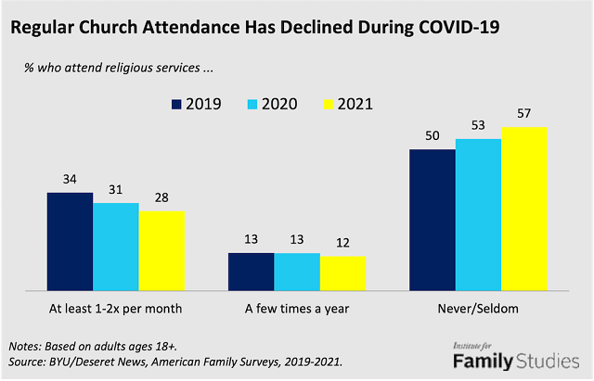
According to data collected in April and May 2020 by Barna Group, one in three practicing Christians dropped out of church completely at the beginning of COVID-19. Moreover, church membership in the US dropped below 50 percent for the first time in 2020, according to Gallup data dating back to 1940.

Slide 11
GENTILES
The Old Man
Ephesians 4:17-19
Vanity
Darkened
Alienated
Condition
Ecclesiastes 1:10 “Is there a thing whereof it may be said, See, this is new? it hath been long ago, in the ages which were before us.” ASV
Ignorance
Hardness of heart
Cause
Lasciviousness
Uncleanness
Greediness
Consequences

Slide 12
Changes Occur
The World Changes
Religious conditions change. Exodus 32;
Judges 2:10ff; 1 Samuel 8; 1 Timothy 2:11-12;
1 Corinthians 14:34-35; Matthew 19:9;
2 Timothy 3:14

Slide 13
Things To Remember
The Sinful State Of The World Can Help Christians To Shine. Matthew 5:13ff;
Philippians 2:14-16; 1 Timothy 4:12
World often sees hypocrisy. cf. 1 Timothy 4:1-2;
Matthew 23:15, 29-33
  John 5:44, “How can ye believe, which receive honor one of another, and seek not the honor that cometh from God only?”
  Micah 6:8, “He hath showed thee, O man, what is good; and what doth Jehovah require of thee, but to do justly, and to love kindness, and to walk humbly with thy God.”

Slide 14
Things To Remember
We Must Teach Our Children How To Live In A Wicked World.
1 John 5:19, “We know that we are of God, and the whole world lieth in the evil one.”
Deuteronomy 4:9-10; 6:6ff; 20ff; Deuteronomy 31:9-13; etc.
Exodus 12:24; Joshua 4:20ff
Ephesians 6:4

Slide 15
Things To Remember
Christians Must Not Overlook The Importance Of Righteousness In A Wicked World.
Christians are the salt of the earth. Matthew 5:13
Proverbs 14:34, “Righteousness exalteth a nation; But sin is a reproach to any people”
cf. Genesis 18:23-33
Sin is likened to leaven. 1 Corinthians 5:6
Christians can make a difference. cf. Titus 2:11-12

Slide 16
Things To Remember
There Is Reason For Optimism.
Romans 1:16-17, “For I am not ashamed of the gospel: for it is the power of God unto salvation to every one that believeth; to the Jew first, and also to the Greek. For therein is revealed a righteousness of God from faith unto faith: as it is written, But the righteous shall live by faith.”
NOTE: 2 Timothy 4:2-4

Slide 17
Mark 16:15
“Go ye into all the world, and preach the gospel to the whole creation.”
The “unlikely” just may listen and obey
  Religious/Gentile – Cornelius (Acts 10)
  Non-Religious – Simon (Acts 8:9-13)
  Worldly – Corinthians ( Acts 18:8;
  1 Corinthians 6:9-11)
  Ignorant – Jews (Acts 2:23; 3:17)
  Persecutor – Saul (Acts 8:3; 9:1-2;
  1 Timothy 1:15)
  Political – Jailor (Acts 16:31-33)

Slide 18
Mark 16:15
“Go ye into all the world, and preach the gospel to the whole creation.”
Gospel Message – Redemption / Salvation
  How we are saved? (1 Corinthians 15:1-4)
  Peter’s sermon – salvation from sin. (Acts 2)
  Peter’s sermon to Cornelius. (Acts 10:34-43)
  Paul’s sermon in Antioch. (Acts 13:23-38)
  Paul’s sermon on Mars Hill – salvation.
  (Acts 17:22-31)

Slide 19
What Does The Future Hold?
“For ye have not passed this way heretofore.”
Joshua 3:4
Depends On YOU TODAY.
Joshua 24:15
“And if it seem evil unto you to serve Jehovah, choose you this day whom ye will serve; whether the gods which your fathers served that were beyond the River, or the gods of the Amorites, in whose land ye dwell: but as for me and my house, we will serve Jehovah.”

